Slide 1
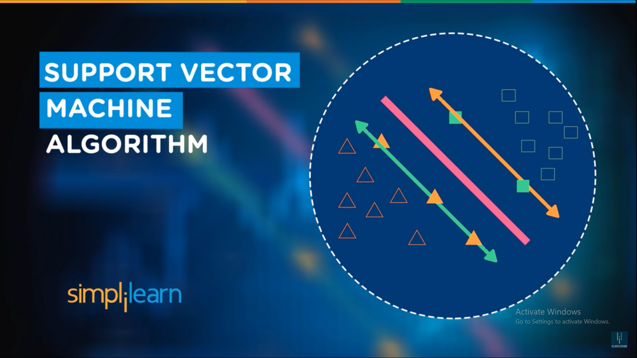

Dr. Shailesh S
DCS CUSAT

Slide 2
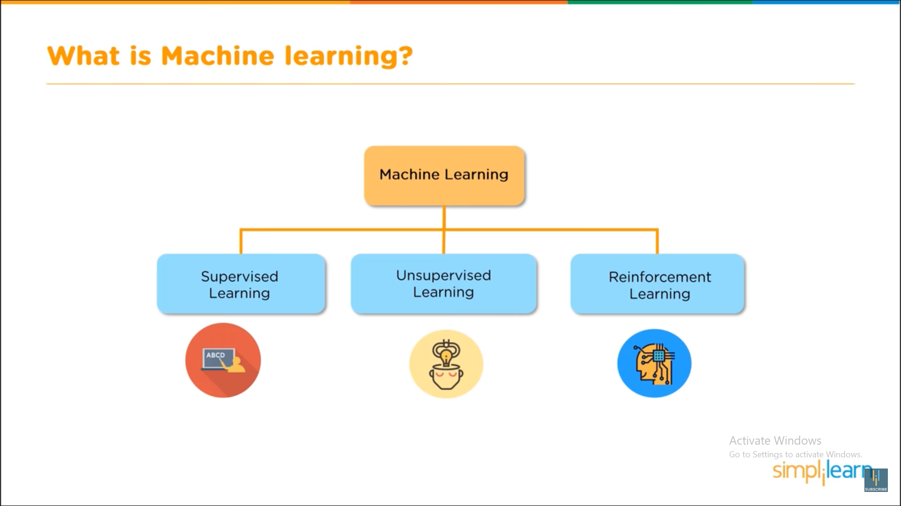


Slide 3
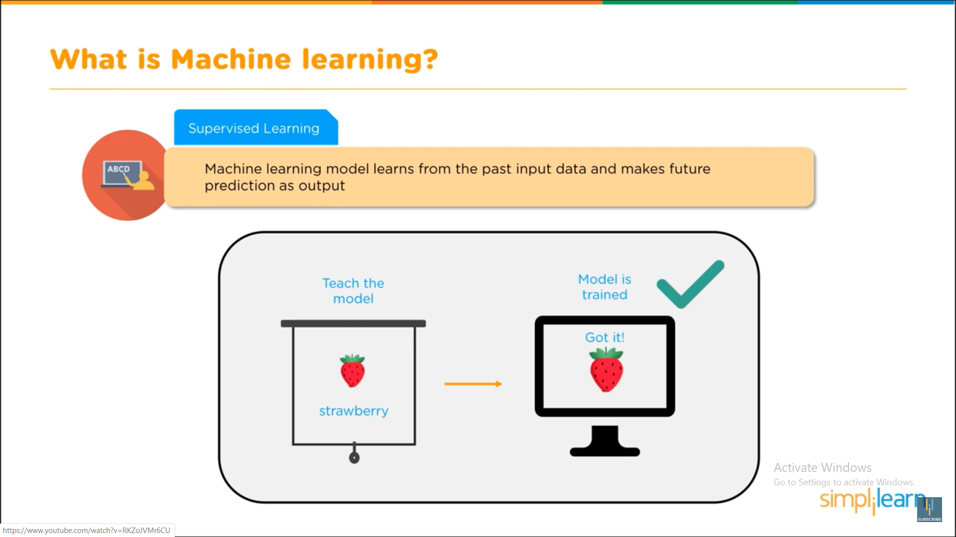

Slide 4
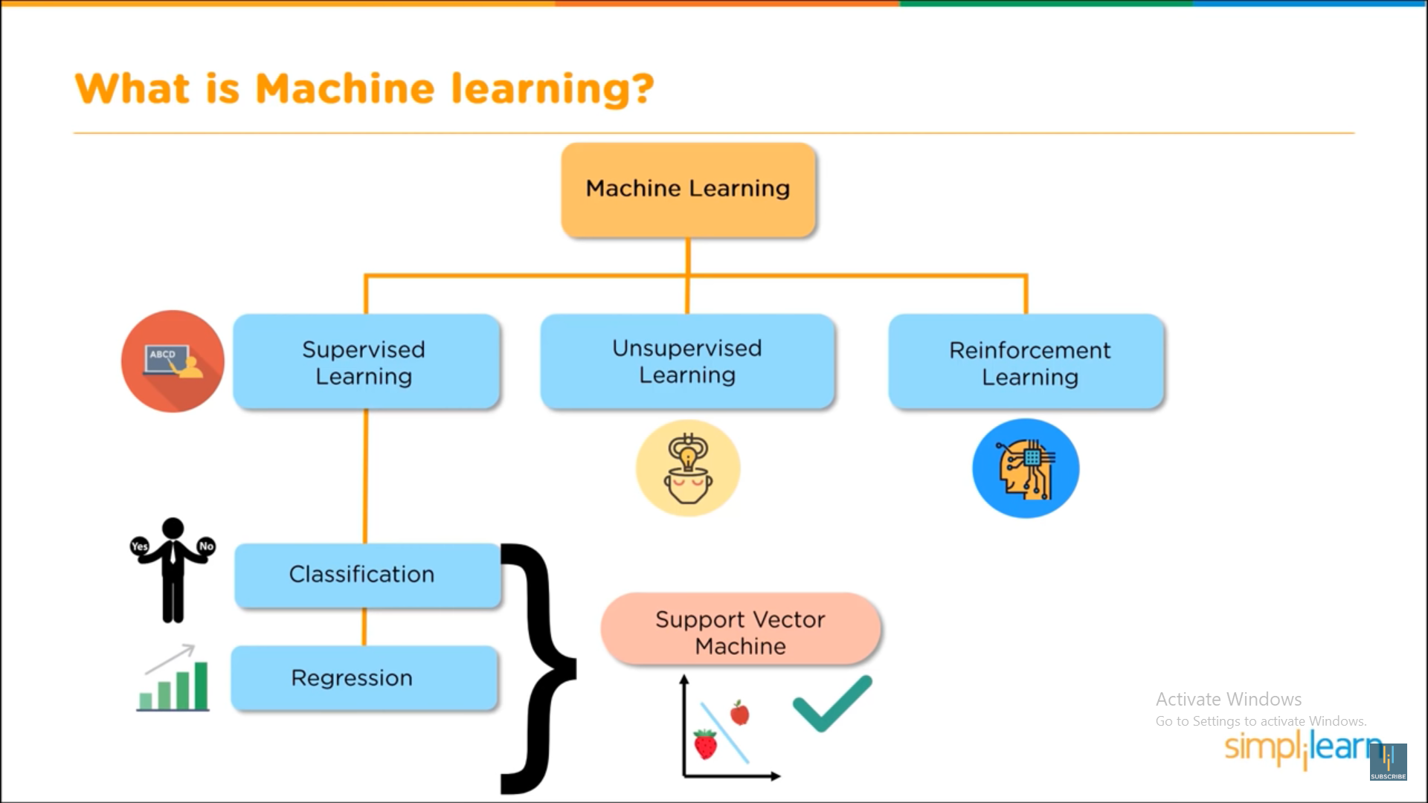

Slide 5
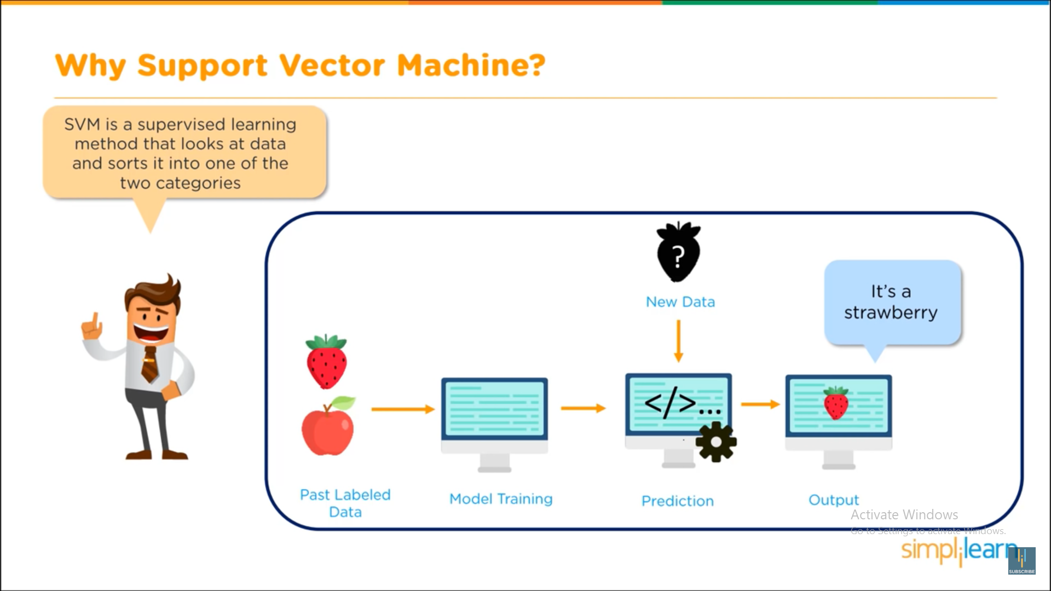

Slide 6
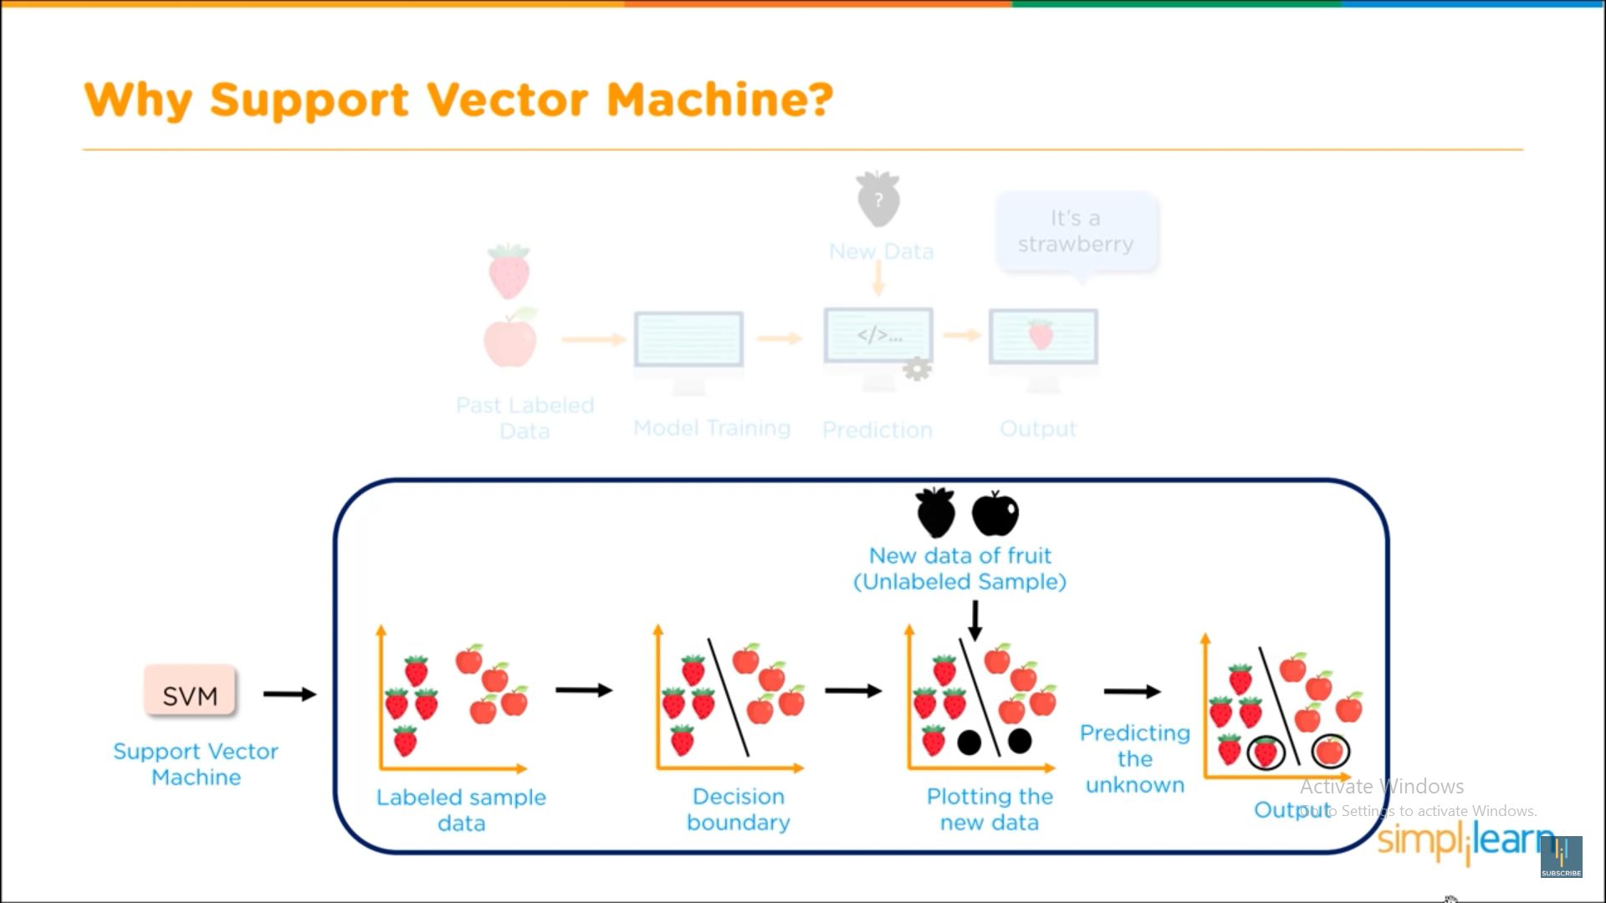

Slide 7
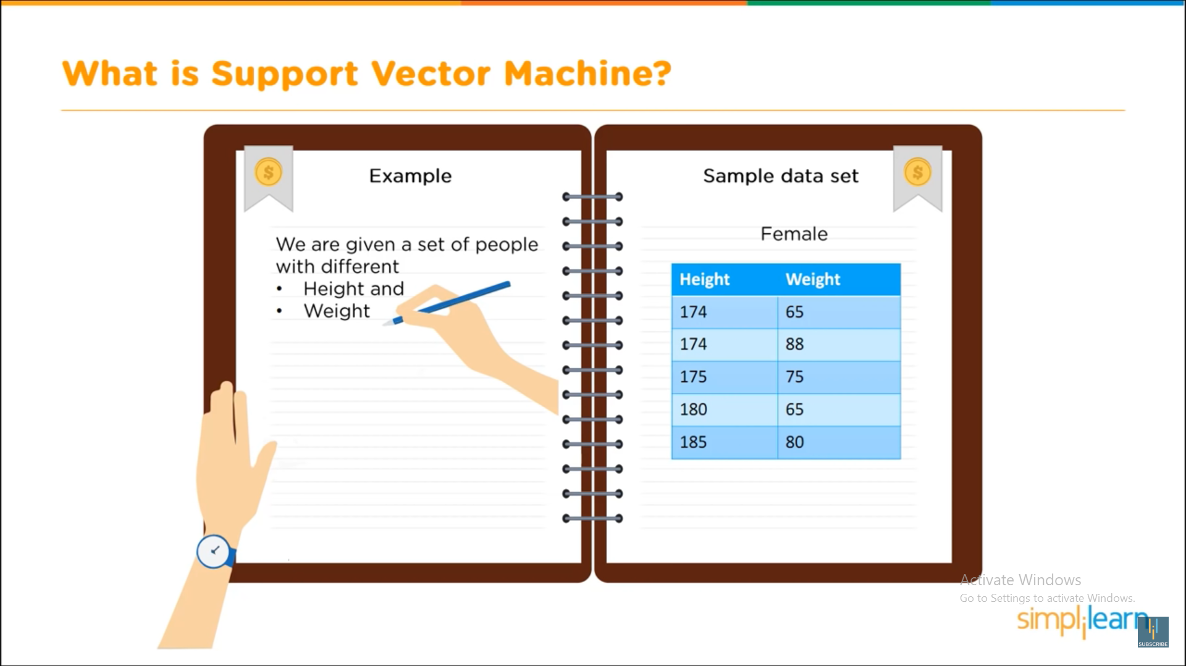
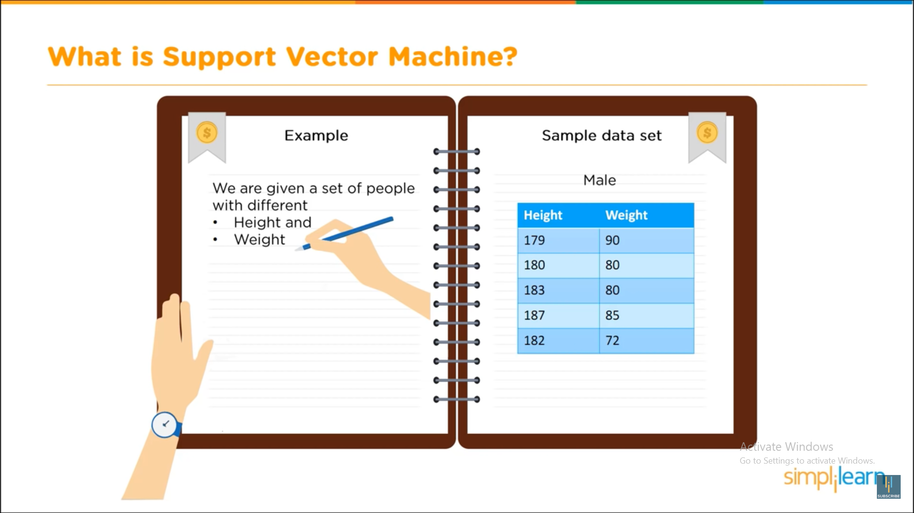

Slide 8
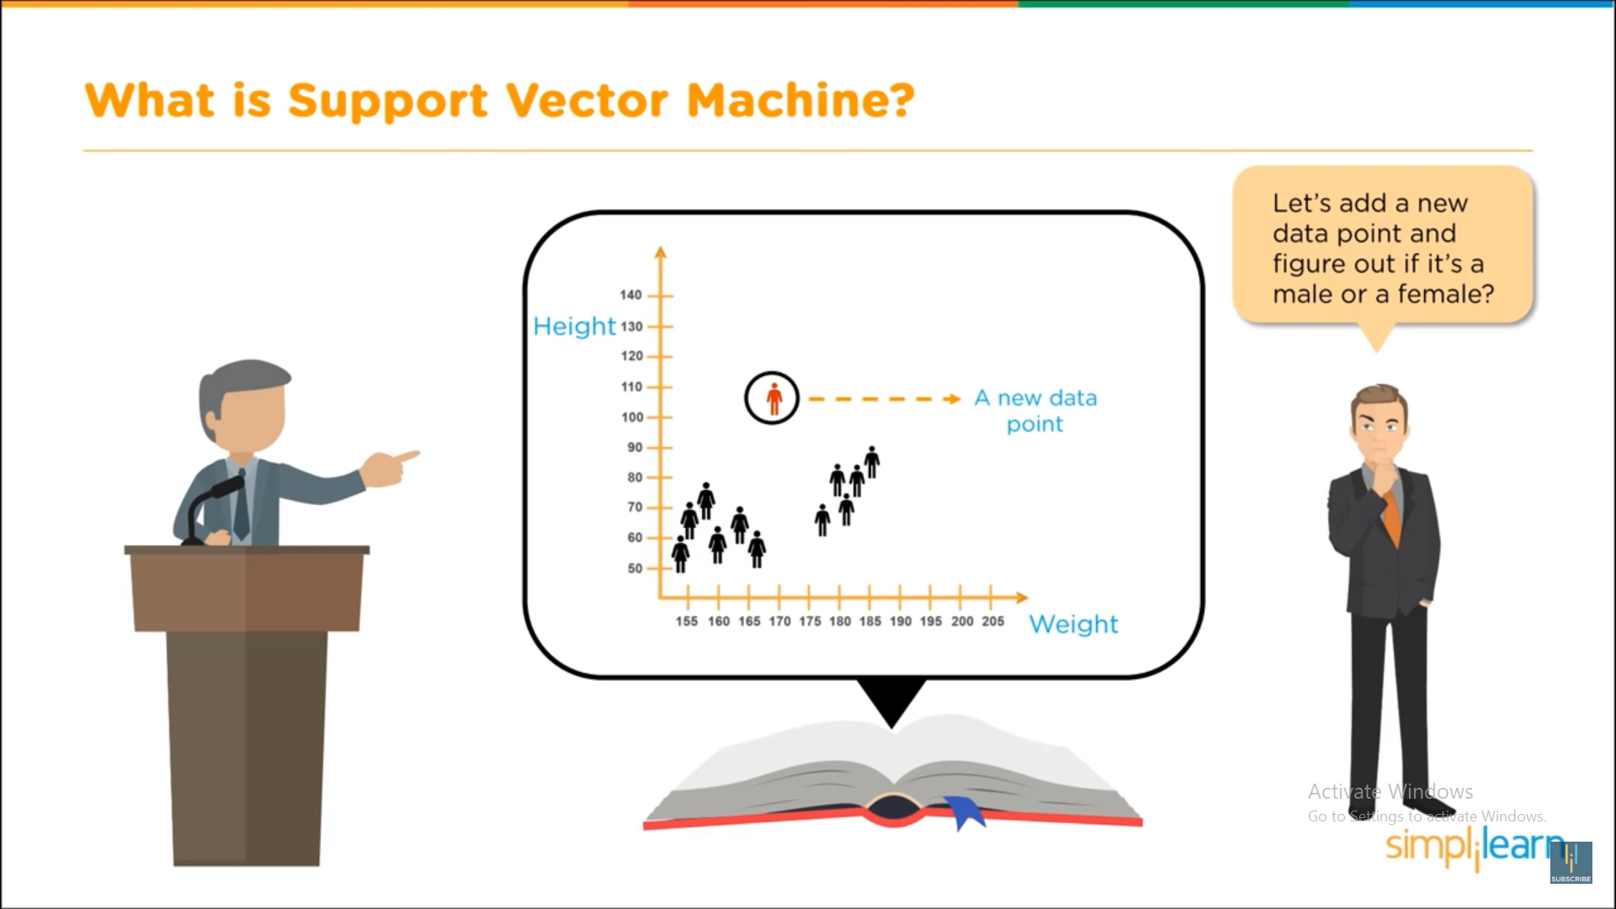
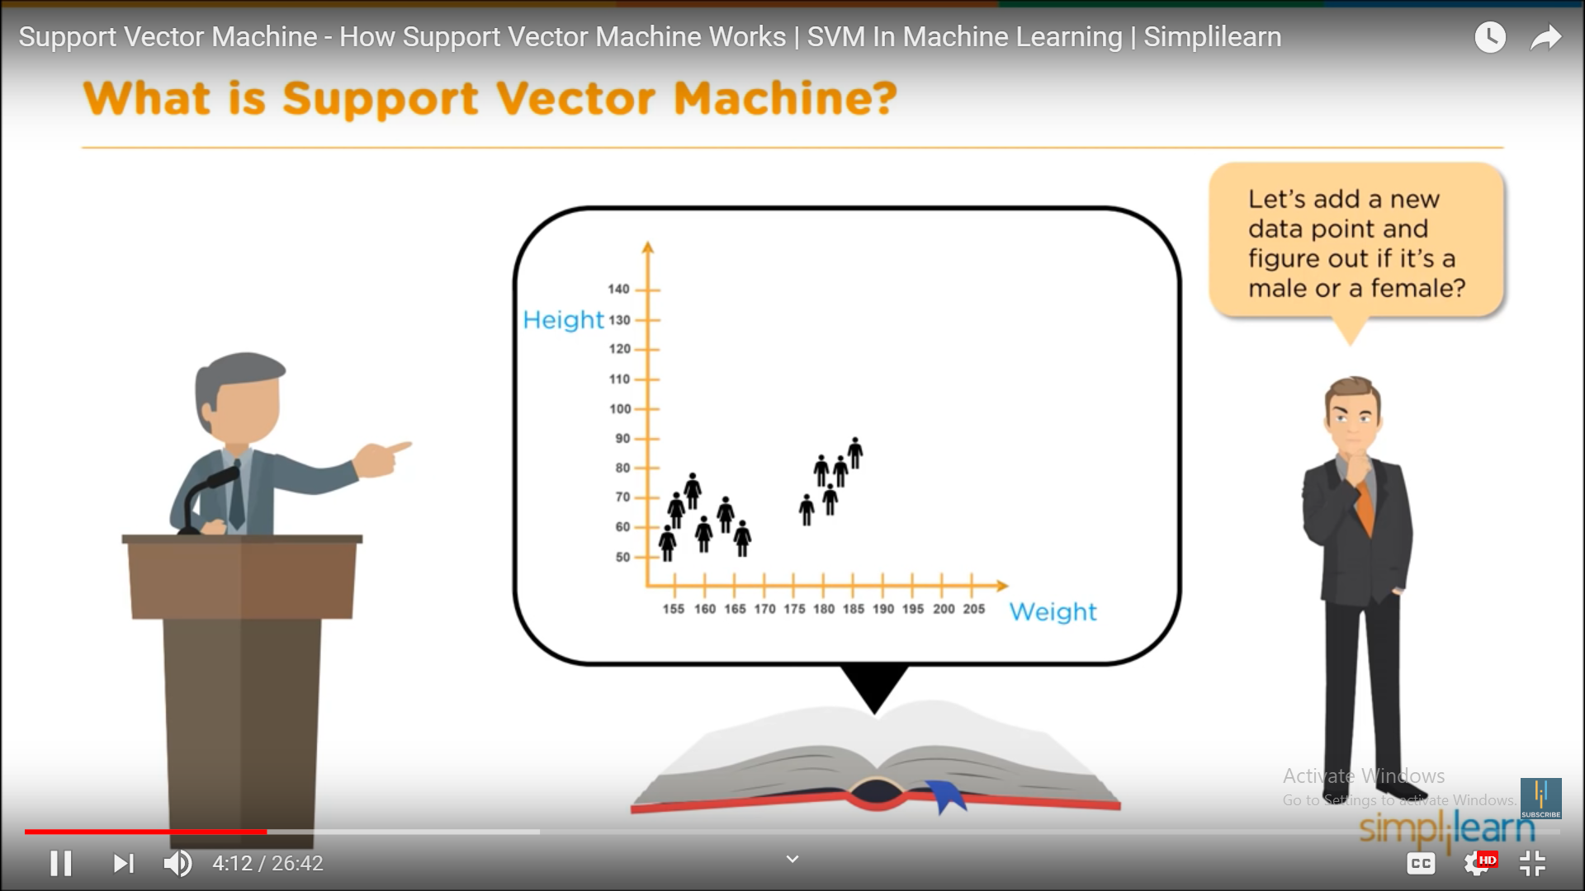

Slide 9
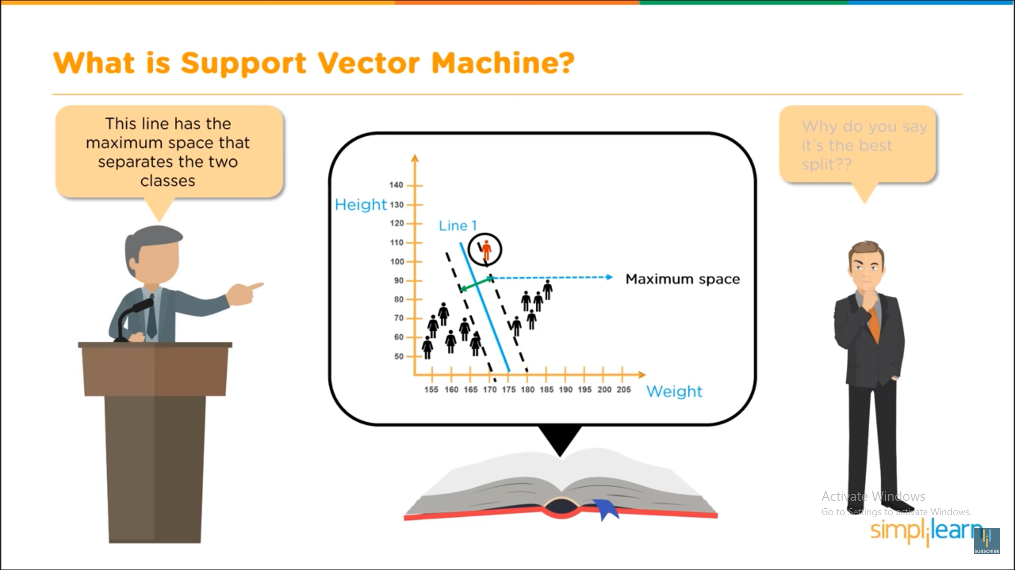
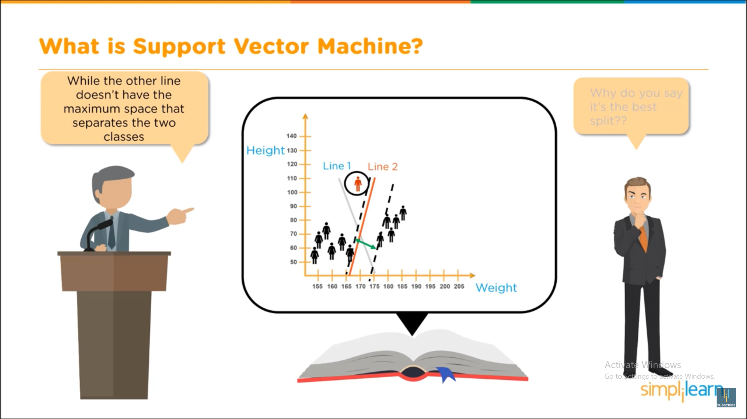

Slide 10
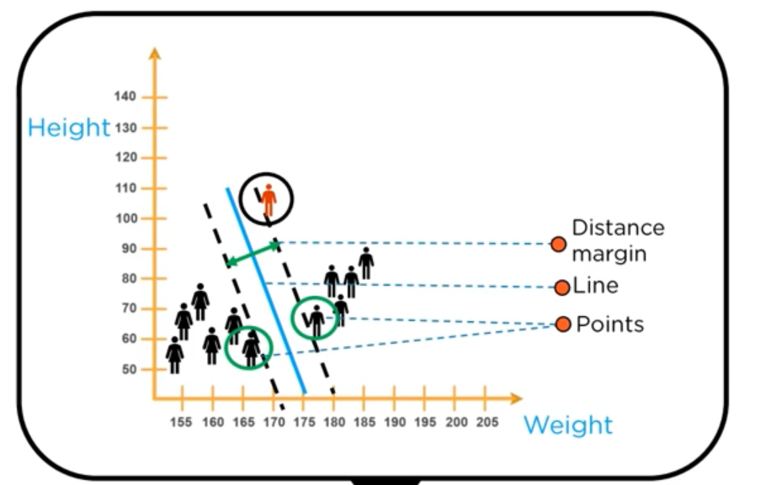

Slide 11
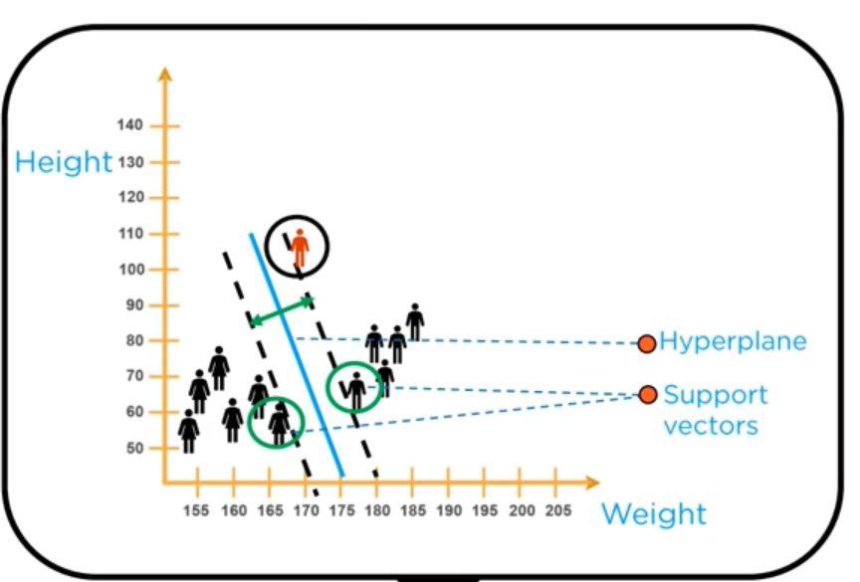
Optimal hyper plane

Slide 12
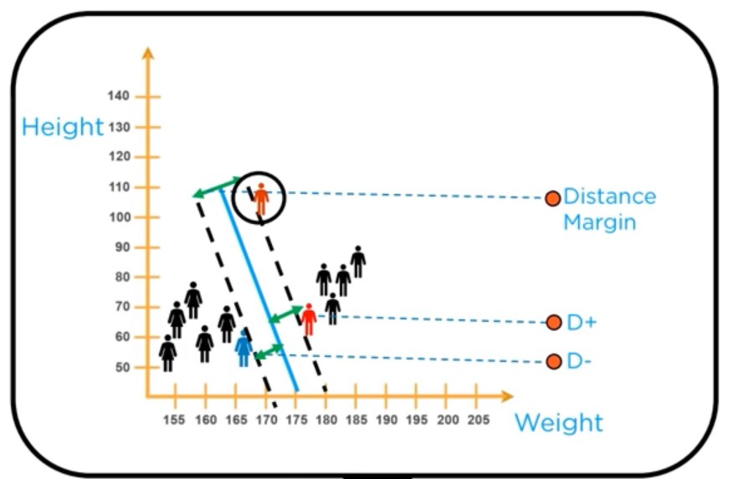
Optimal hyper plane

Slide 13
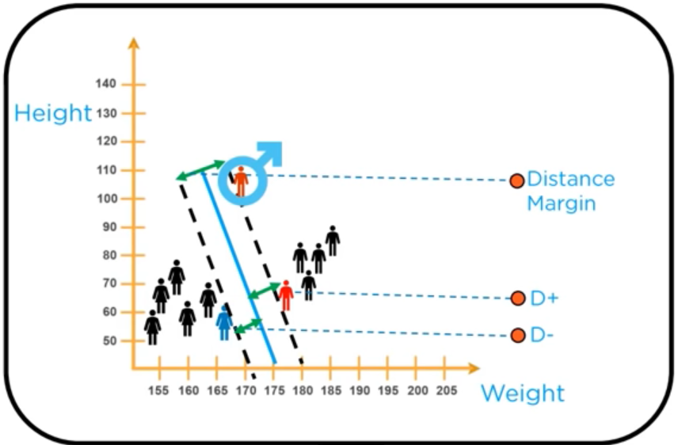
Predict the New Data Item

Slide 14
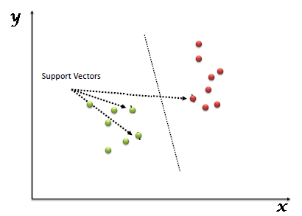
Support Vector Machine
“Support Vector Machine” (SVM) is a supervised machine learning algorithm which can be used for both classification or regression challenges
perform classification by finding the hyper-plane that differentiate the two classes very well

Slide 15
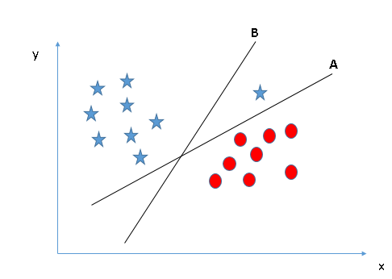
Identify the right hyper-plane (Scenario-3)
Some of you may have selected the hyper-plane B as it has higher margin compared to A

Slide 16
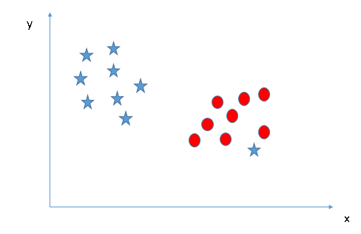
Can we classify two classes (Scenario-4)
outlier for star class

Slide 17
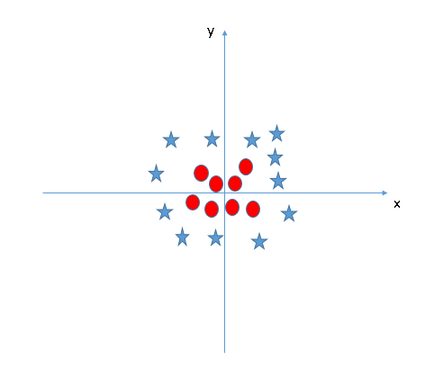
Find the hyper-plane to segregate to classes (Scenario-5)
SVM can solve this problem. Easily! It solves this problem by introducing additional feature.

Slide 18
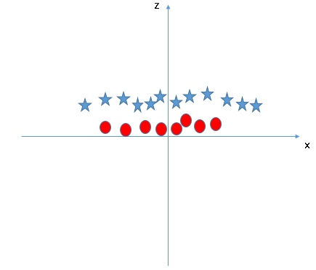
kernel trick.
Here, we will add a new feature z=x^2+y^2.
All values for z would be positive always because z is the squared sum of both x and y
In the original plot, red circles appear close to the origin of x and y axes, leading to lower value of z and star relatively away from the origin result to higher value of z.

